Slide 1
Signal Processing
Tirgul 2 – Quantization and Noise

Slide 2
Quantization
Turning an analog signal into digital (by sampling).
More storage capacity will yield a more accurate reconstruction of the sampled analog signal.
Remember: we will always loss some information!

Slide 3
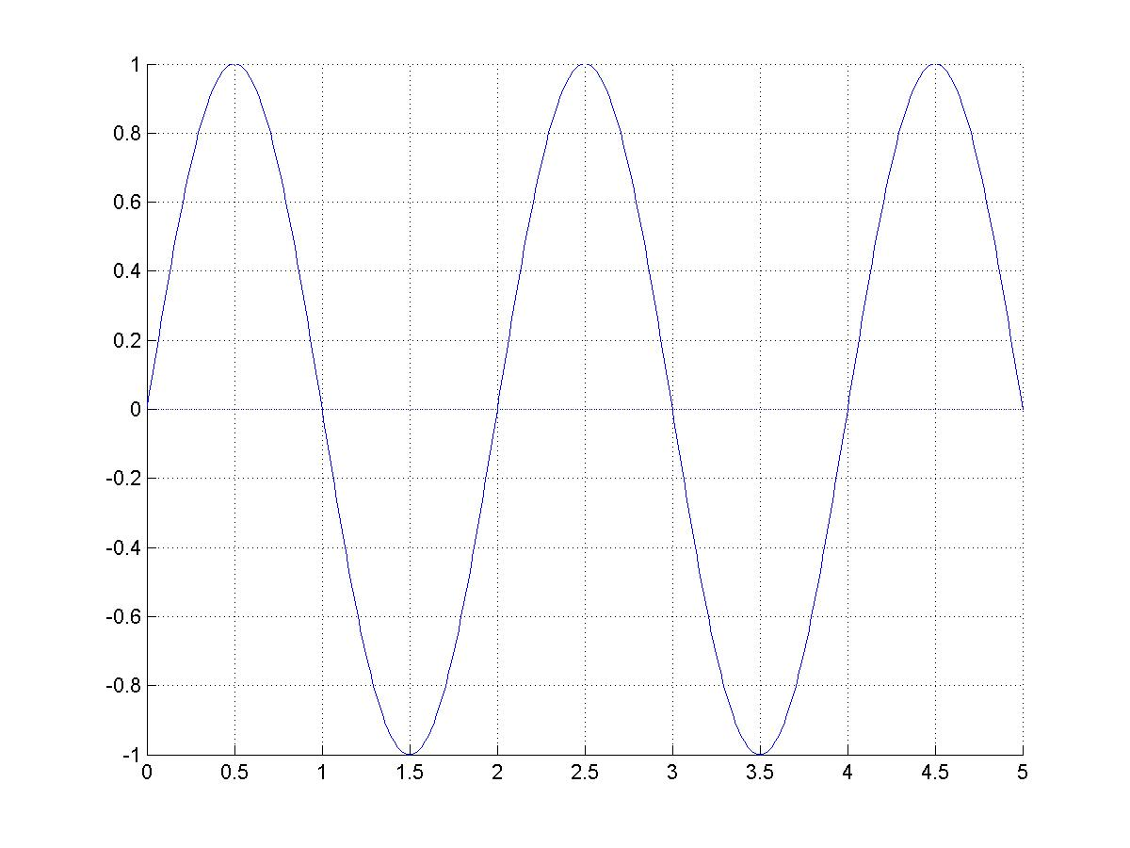
Quantization
Y-axis:
Resolution
X-axis: Sampling rate

Slide 4
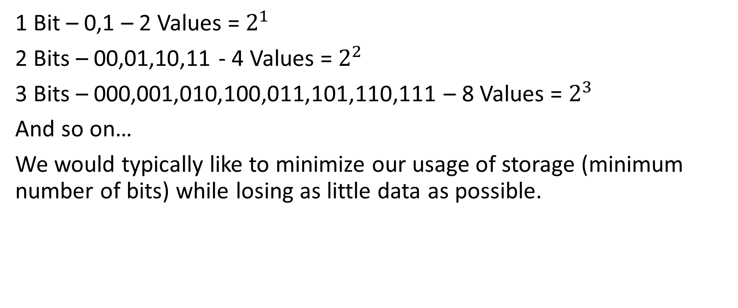
Bits

Slide 5
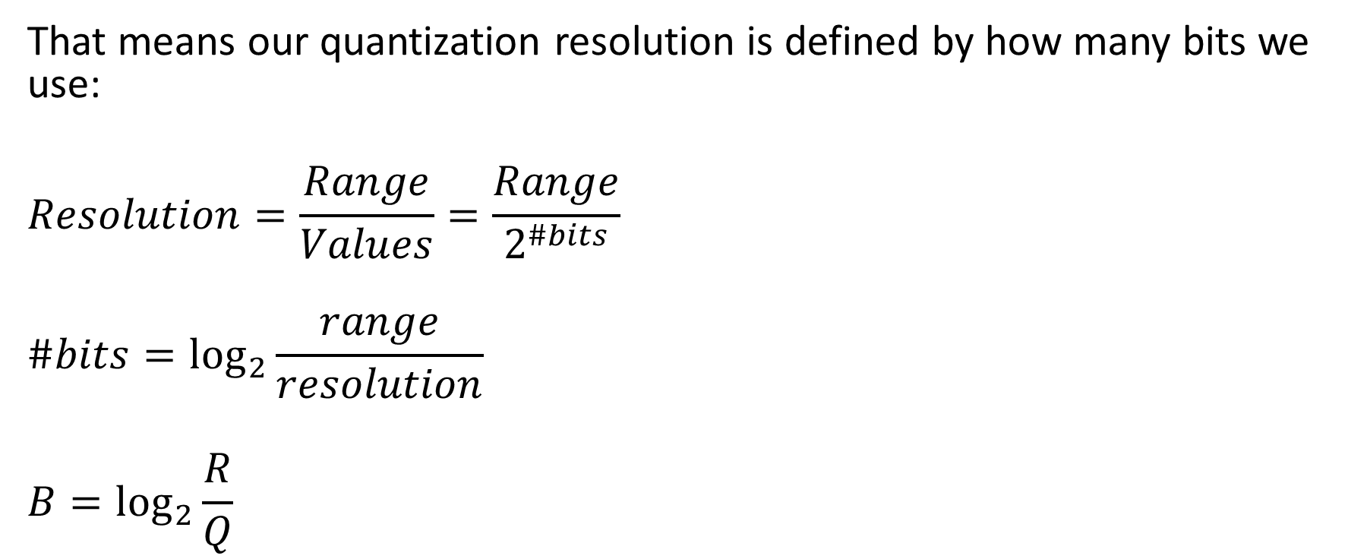
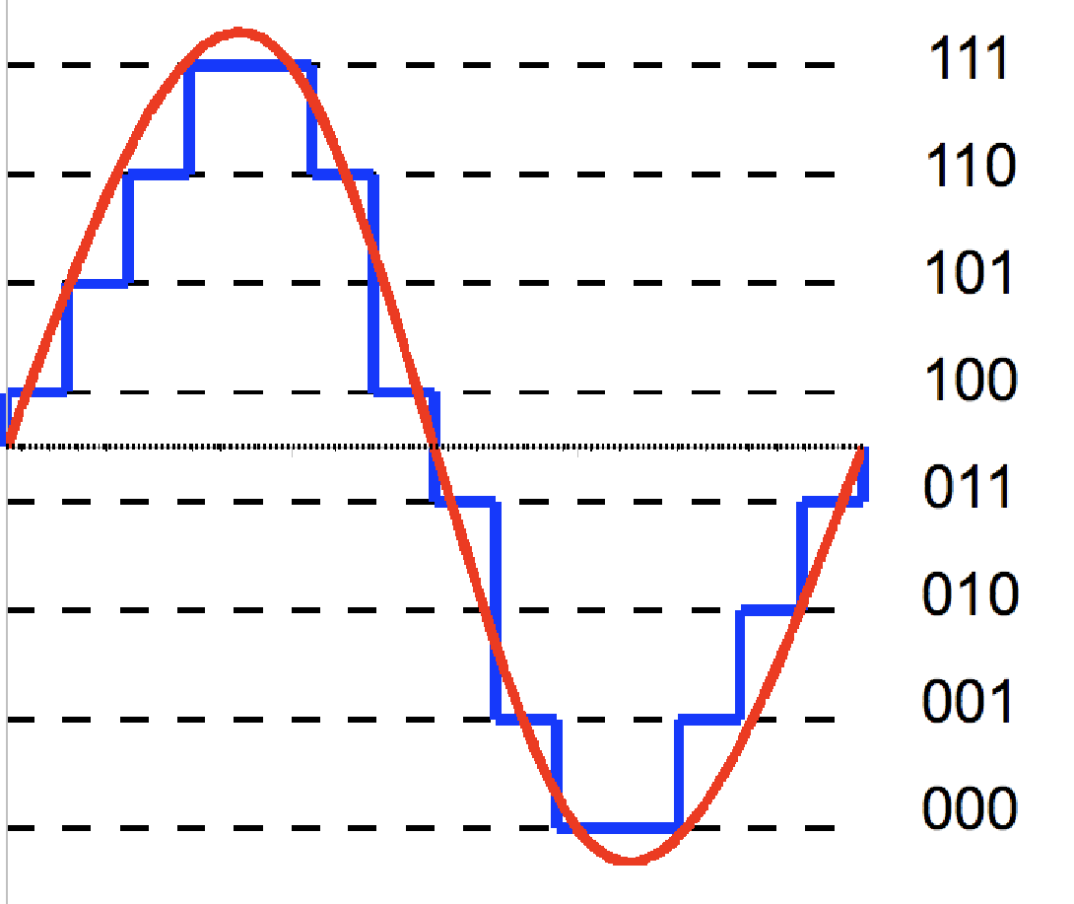
Resolution

Slide 6
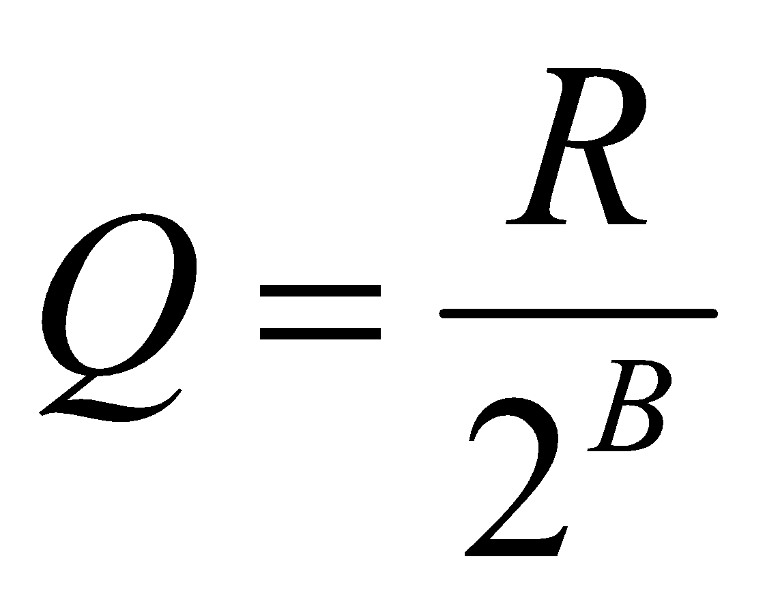
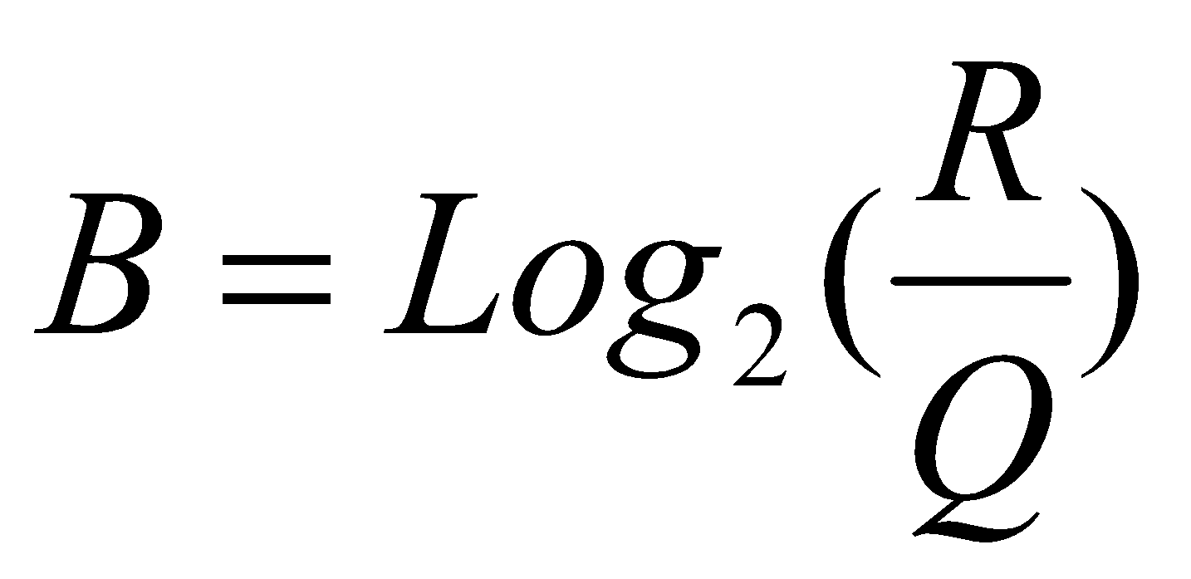
Sampling resolution

Slide 7
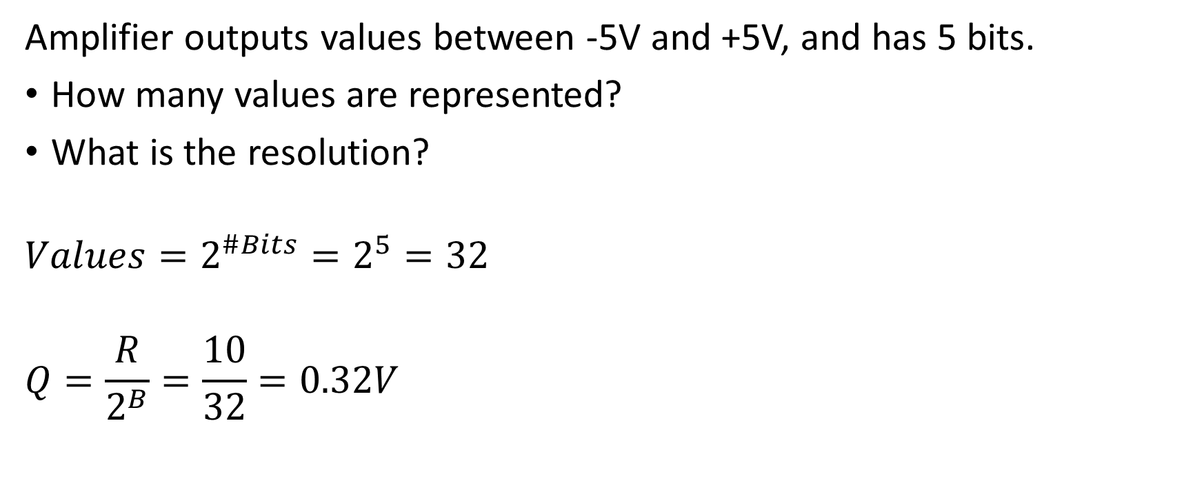
Quantization – Example

Slide 8
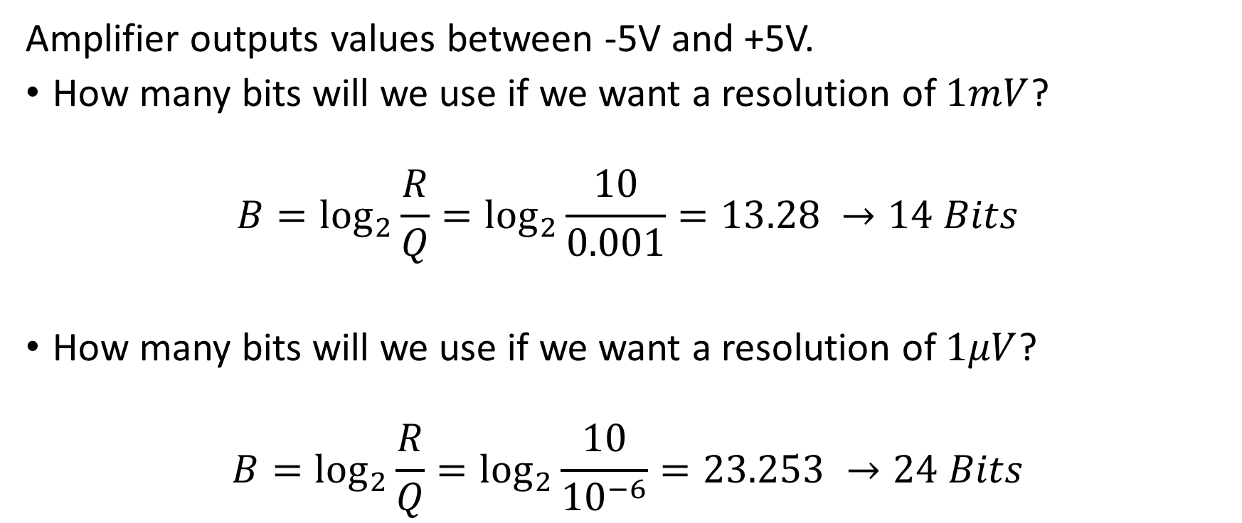
Quantization – Example

Slide 9
Quantization in neural recordings
In electrophysiology recordings the range (R) is typically -5 to 5 volt
If our computer uses 8 bits to store the signal values then we have 2^8 = 256 values
Resolution: [5- (-5)]/256= 0.0398V = 39 mV
We cannot resolve differences below 39mV!, while extracellular recordings range is 100-1000 uV…
Solutions:
Use higher number of bits
Amplify

Slide 10
Quantization in neural recordings
We record neural activity. Our recording system can record signals between -5V to 5V.
How many bits do we need for a 10uV resolution?

Slide 11
Quantization in neural recordings
Solution:
Our range (‘R’) is 10V = 10*10^6uV = 10^7uV.
We want a resolution (‘Q’) of 10uV.
Therefore we will need B bits:
B = log2(R/Q) = log2(10^7/10) = log2(10^6) ~ 20 bits
This is a lot..
We will use an amplifier.

Slide 12
Quantization in neural recordings
Solution:
We will use an amplifier that amplify the signal X1000.
So now the resolution (‘Q’) is 10uV X 1000 = 10 mV.
Therefore we will now need:
B = log2(R/Q) = log2(10^4mV/10) = log2(10^3) ~ 10 bits

Slide 13
Example
Spikes can range between -50 to 200 uV
We use an A/D with ±5V range with a 1000X amplification with a 8 bits.
Original range: 10V. After amplification, a spike of 10uV is amplified into 10mV. Therefore the range after amplification is 10mV instead of 10V.
Q=10mV/2^8 = 0.039 mV = 39 uV.

Slide 14
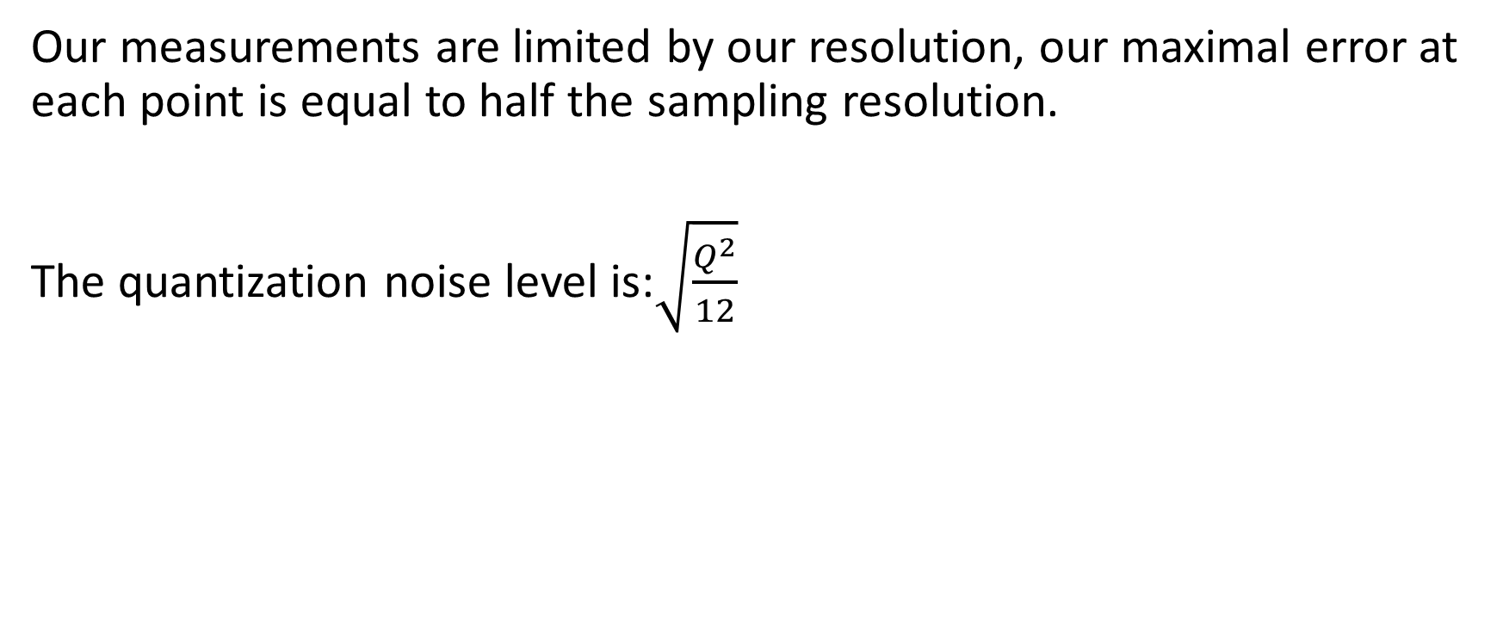
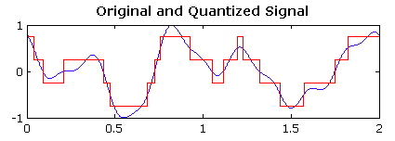
Quantization Noise

Slide 15
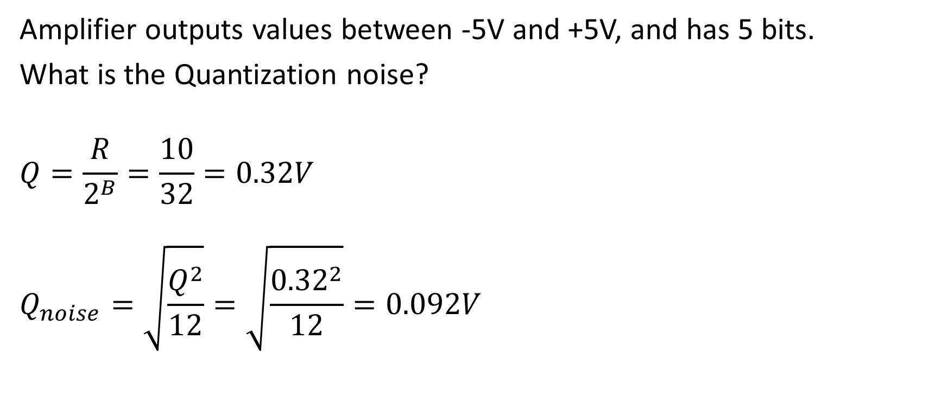
Quantization Noise - Example

Slide 16
Noise and signal-to-noise ratio (SNR)

Slide 17
What is noise?
Everything we don’t want to measure:
Random noise
System noise

Slide 18
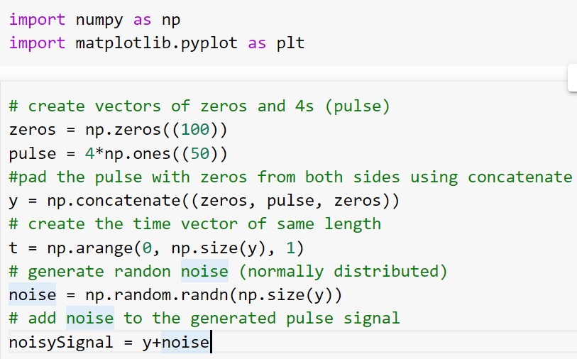
Generating a noisy signal – Example 1

Slide 19
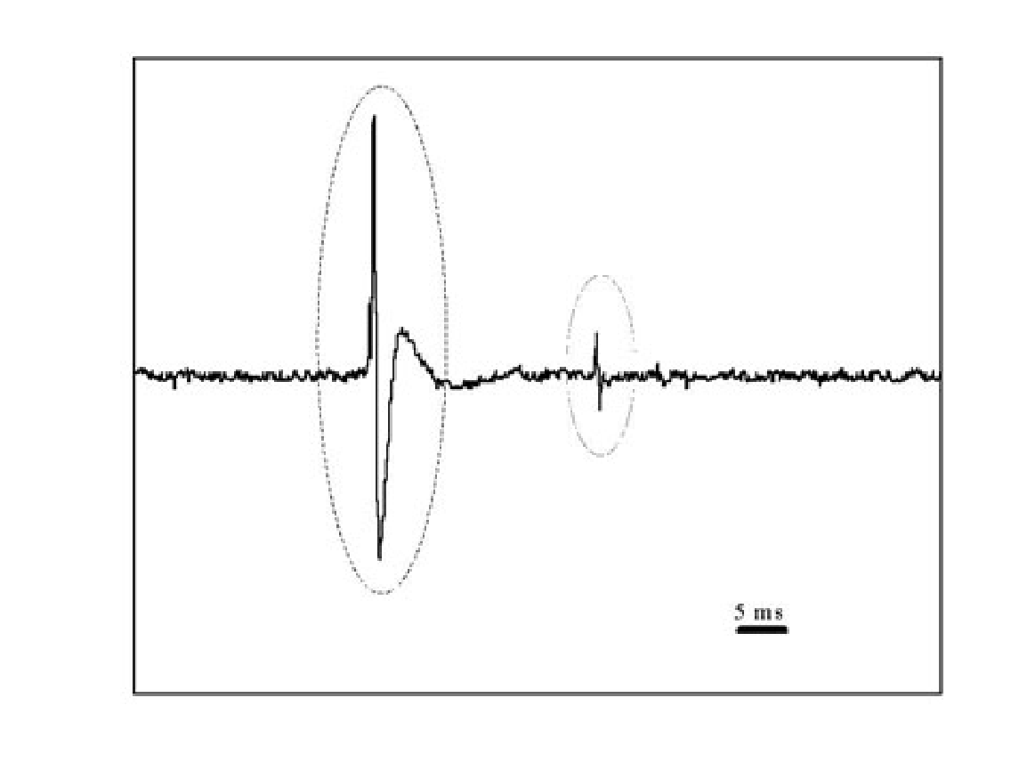
Estimating the signal quality - SNR
SNR – Signal to Noise Ratio

Slide 20


Signal Energy and Power
Energy :
Power :

Slide 21
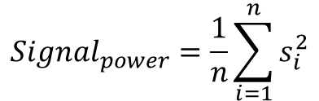
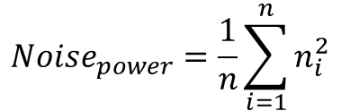
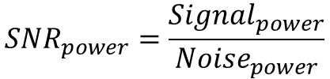
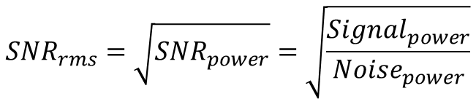
Estimating the signal quality - SNR
SNR – Signal to Noise Ratio
“The ratio between the signal power
and the background noise power”

Slide 22
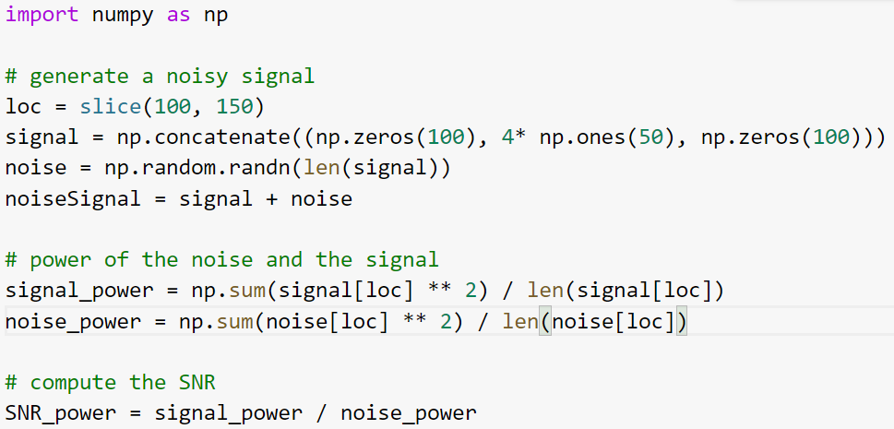
Back to Example 1 – Calculating SNR power

Slide 23
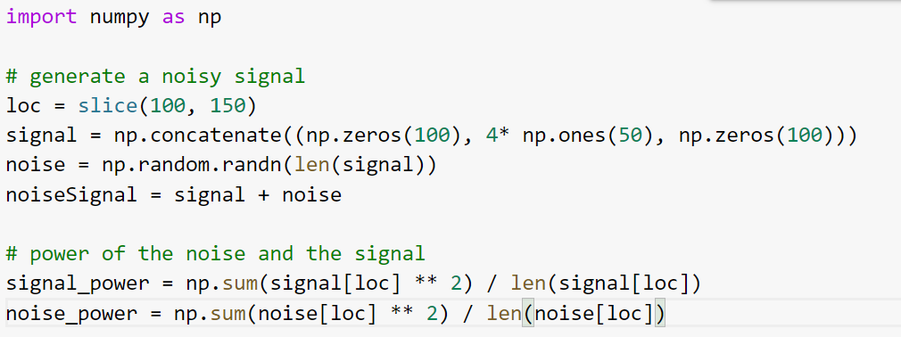
Example 1 – Alternative SNR calculation
The signal is positive and the noise has zero mean

Slide 24

Estimating the signal quality - SNR
SNR – Signal to Noise Ratio
If the signal gets only positive values, and the noise has a zero mean, we can use the alternative calculation:
AKA: SNR_rms = mean(signal)/STD(noise)

Slide 25
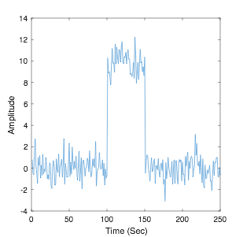
SNR: classic definition
The signal is positive and
the noise has zero mean.
SNR:
np.mean(signal)/np.std(noise)

Slide 26
SNR : special case
In case where the signal is constant and the noise has zero mean we can compute the SNR as follow:
np.mean(noisy_signal) / np.std(noisy_signal)

Slide 27
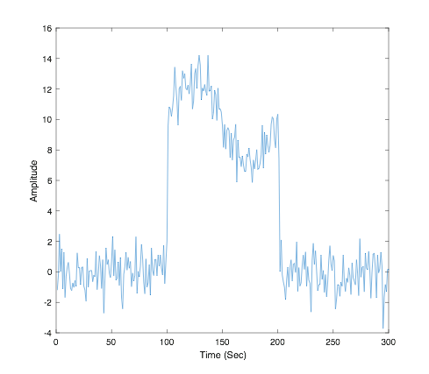
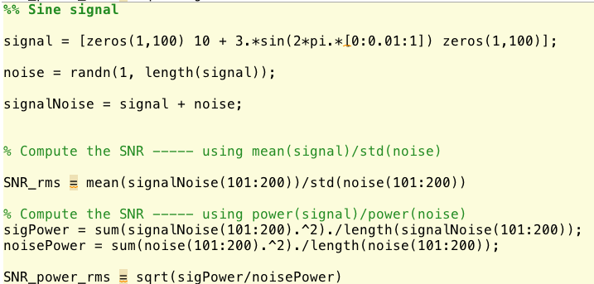
SNR - Example
Compute the SNR of the signal using both methods:

Slide 28
Quantify neurons SNR - Example
A neuron is firing 2 spikes per second without a stimulus.
With a stimulus, it fires 7 spikes per second.
The neurons firing is Poisson distributed all the time.
What is the signals S/N ?
Answer:
Signal’s mean : 7 - 2 = 5
Signal std: sqrt(7)
Therefore: S/N = 5/sqrt(7) = 1.89

